Slide 1
SMART TRAFFIC MANAGEMENT SYSTEM
varun

Slide 2
Team Members:
Varun Reddy Musku
Chakradhar Prathivada
Tejaswini Challa
Shruthi Battu
Sumanth raja Ghanta
Rohan Reddy Kondaveeti
Varun

Slide 3
Contents
Introduction.
Problems faced in Real-time scenario.
Approach to the problem.
How does it work?
RFID(Radio Frequency Identification) sensors.
RFID Implementation.
Central Traffic Management Server.
Implementation of Green corridors.
varun

Slide 4
Introduction
Urban mobility is one of the major problems, especially in metropolitan cities. Previous traffic management systems are not capable enough to tackle this growth of traffic on the road networks.
The city requires a smart and intelligent traffic management system to deal with traffic-related problems such as traffic jams, emergency vehicle clearance, etc.
An algorithm is used to predict the traffic density for the future to minimize traffic congestion.
Emergency vehicles demand quick and safe passage as it aims at saving the life of a patient. It is becoming a serious problem in our society and an optimal solution where normal traffic flow is least disrupted as well as emergency vehicles too could move quickly is highly desired.
Varun

Slide 5
Problems faced in Real-time scenario.
In the current scenario, one of the serious concerns for people in smart cities is traffic congestion. This has turned out to be a daily problem in the current time.
Due to this road congestion accidents in the city have been raised to a great extent so lives lost due to accidents are even more crucial.
Due to this congestion on the roads, emergency vehicles such as ambulances, fire cars, and other vehicles cannot reach on time.
Chakri

Slide 6
Approach to the problem
Through IoT-enabled technology, we can solve these issues by creating "Green Corridors" for emergency vehicles.
The system gives emergency vehicles the benefit of a green corridor and reaches their destination on time.
The RFID reader scans the RFID tag applied on the ambulance and updates upcoming traffic lights to switch to green and displays a message to vehicles ahead of the ambulance to provide a "Green Corridor" by shifting other lanes
Chakri

Slide 7
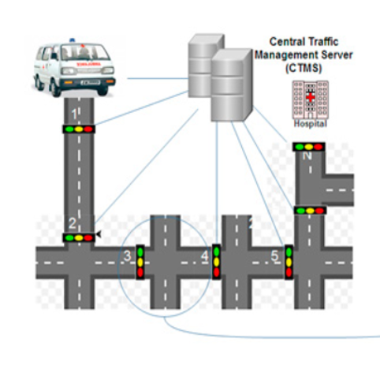
Formulation
If an emergency vehicle is of a very critical nature, the RFID tag attached to the vehicle sends a message to the Central Traffic Management Server(CTMS)
It contains the information about the vehicle and reads the information about the emergency vehicle enabling the Green corridors which provide a path from source to destination
Teju

Slide 8
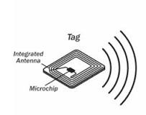
RFID sensors
Radio Frequency Identification or RFID is a specific type of radio technology that uses radio waves to identify tags attached to an object and thus identifies the object
The tag contains a transceiver chip that is triggered by the electromagnetic wave from the RFID reader and transmits an identification number back to the reader.
Tags can be passive or active.
Passive tags are only powered by the incident electromagnetic wave from the reader and thus have a shorter operating range.
Active tags are powered by a battery and can have a greater range, up to hundreds of meters.
Shruthi

Slide 9
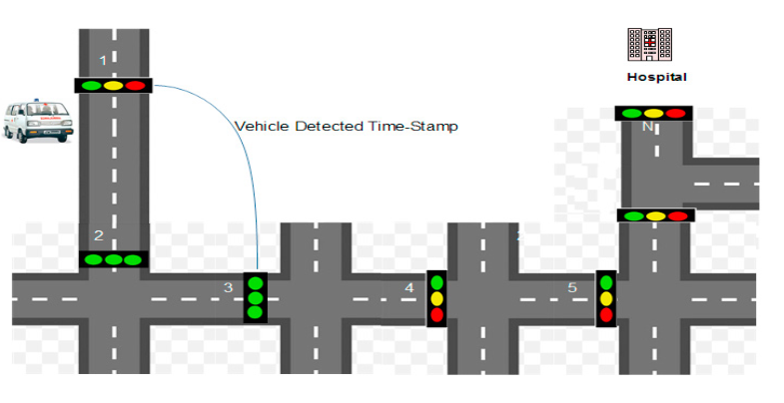
RFID Implementation
RFIDs are used to prioritize emergency vehicles like ambulances, fire brigades, etc. by implementing RFID tags in such vehicles.
Here we are using RFID sensors, it is used to get the live status of that vehicle to the Central traffic management server.
In this scenario emergency vehicle sends a request for the green corridor to CTMS through RFID tags. The request message consists of three information fields namely, Unique Vehicle Identity (UVId), coordinates of source, and destination.
After the approval of the green corridor, CTMS sends UVid (unique vehicle id) information to all TPs. On receiving the UVId, all the TPs turn the traffic signal green, thus creating a green corridor.
Shruthi

Slide 10
Central Traffic Management Server(CTMS)
Central Traffic Management Server (CTMS) is deployed at the center of the city which communicates with different traffic posts.
After getting the request from an emergency vehicle, CTMS sends an alert message to all relevant traffic posts situated between the source and the destination of the vehicle.
All the traffic posts make the traffic signals green for creating a green corridor when a request for Green Corridor is made.
This will create a dedicated path from the source to the destination, allowing only the emergency vehicle. Therefore, other vehicles must face a delay until the emergency vehicle reaches its destination.
To avoid this problem, a dynamic real-time green corridor is created in a way such that only a part of the route is cleared for the emergency vehicle.
Sumanth

Slide 11
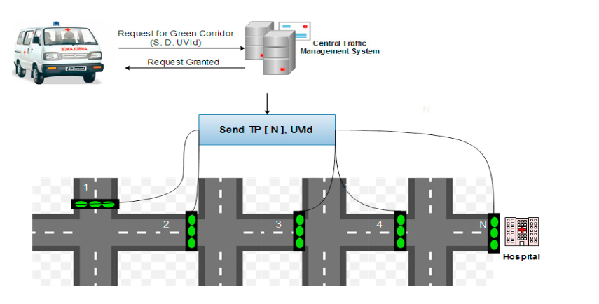
Implementation of Green corridors
The vehicles create congestion on the road, due to which emergency vehicles like ambulances, fire brigade, and police vehicles are unable to reach the destination.
To avoid this problem, a dynamic real-time green corridor is created in a way such that only a part of the route is cleared for the emergency vehicle.
If an emergency vehicle is of a very critical nature, one should go for a dedicated green corridor that reduces travel time.
Sumanth

Slide 12


